Slide 1


CITS1003 Introduction to Cybersecurity [7] Incidents exercises
Dr Zhi Zhang

Slide 2
Automation
CALDERA
ADTool
Project Overview

Slide 3
CALDERA
What is CALDERA?
It is an open-source cyber security platform designed to automate adversary emulation, automate incident response, etc.

Slide 4
CALDERA
Installation
Open a Linux VM
Run the following commands:
sudo apt install python3-pip
git clone https://github.com/mitre/caldera.git --recursive
cd caldera
pip3 install -r requirements.txt
python3 server.py –insecure

Slide 5
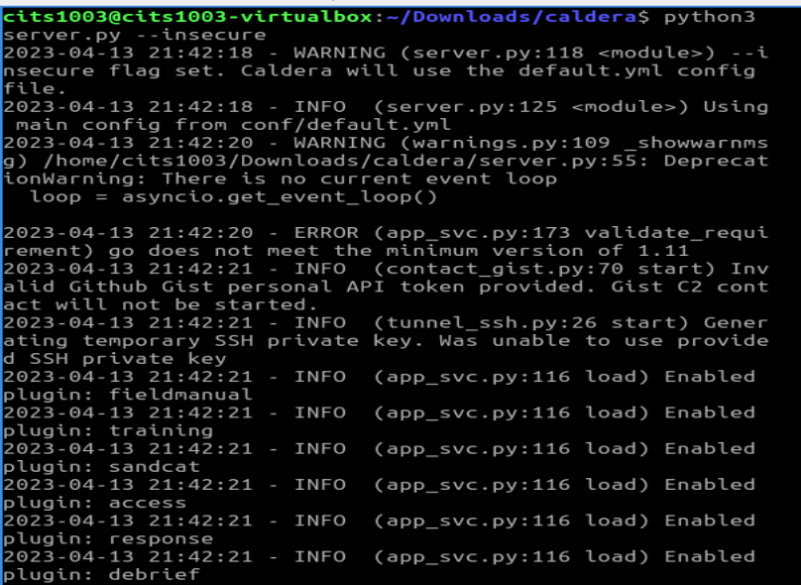
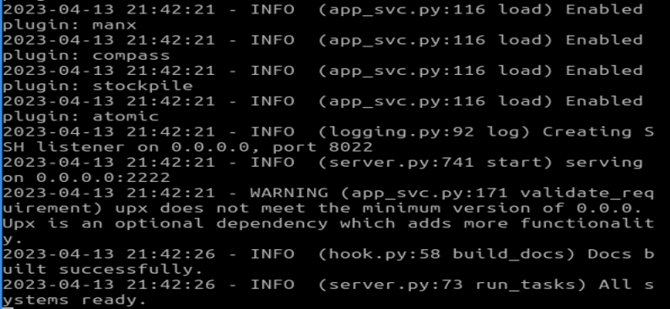

Slide 6
CALDERA
Login
Open a browser
Enter the following URL in the address bar:
http://0.0.0.0:8888

Slide 7
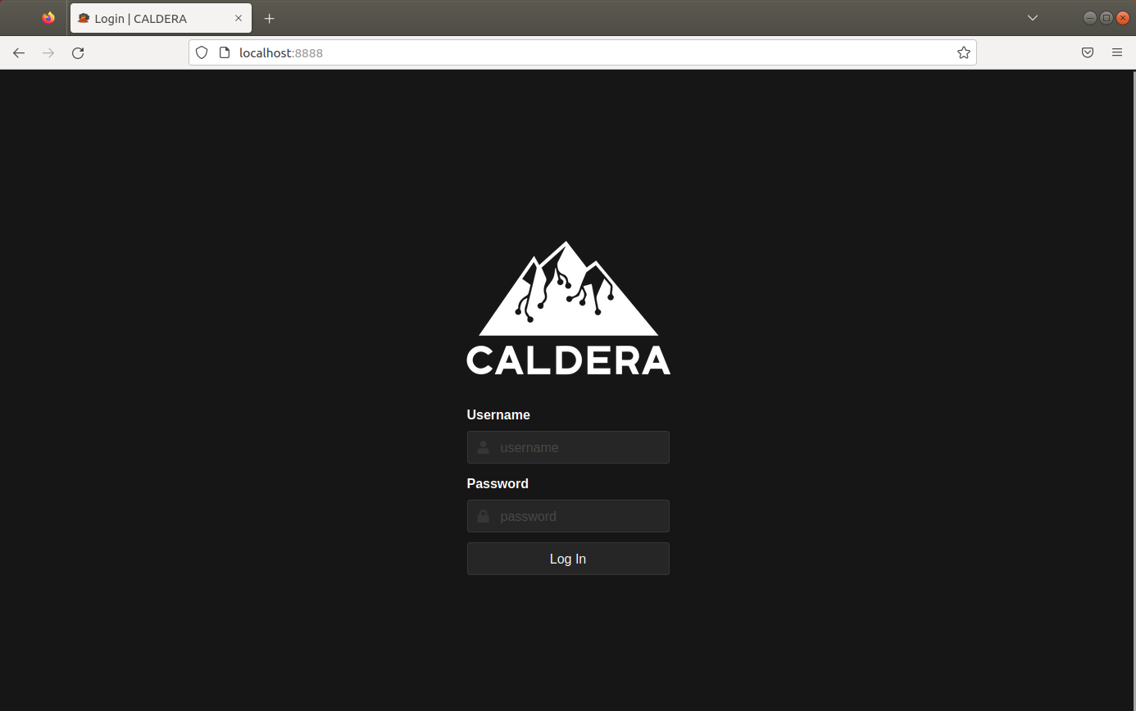
CALDERA

Slide 8
CALDERA
Login
Open a browser
Enter the following URL in the address bar
http://0.0.0.0:8888
At the bottom of caldera/conf/default.vml,
username: red
password: admin

Slide 9
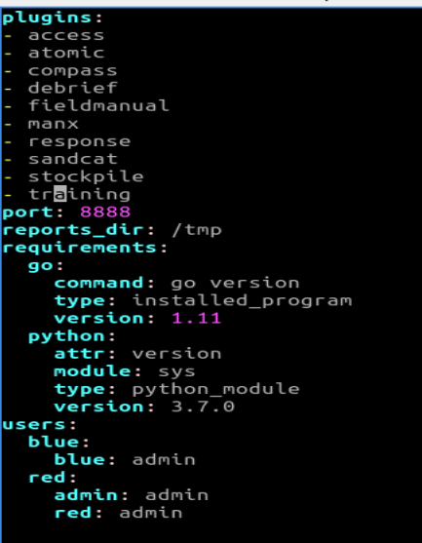
CALDERA

Slide 10
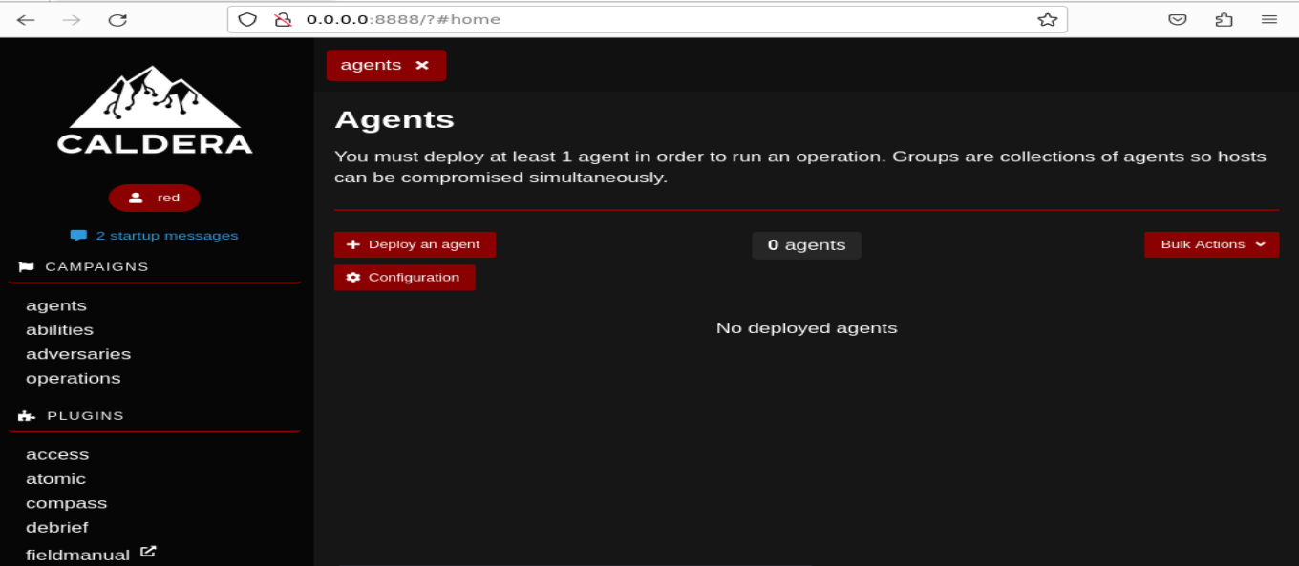
CALDERA

Slide 11
CALDERA
Adversary is a profile of instructions that describe various TTPs (Tactics, Techniques and Procedures) to be performed on a targeted system. An adversary profile can be used to simulate an attack automatically.
Tactics are generalized attack activities.
Techniques are used to achieve a tactic, e.g., a tactic can be “discovery” and its techniques include network users discovery, system users discovery, running process discovery, etc. Thus, a tactic can have several techniques.
Procedures are series of steps that an attacker uses to achieve an attack goal. If an attacker wants to compromise a website, the procedures can involve scanning the target website for vulnerabilities, crafting an SQL query that includes malicious code, and submitting it to an unsecured form on the website to gain control of the server. Each step is an attack ability, which requires a technique. Each required technique can be picked from a tactic.

Slide 12
CALDERA
Adversary is a profile of instructions that describe various TTPs (tactics, techniques and procedures) to be performed on a targeted system. An adversary profile can be used to simulate an attack or evaluate the effectiveness of a security defense.
Agent works as a spy program that is installed on the targeted system and responsible for executing TTPs specified in the adversary profile.

Slide 13
CALDERA
Adversary is a profile of instructions that describe various TTPs (tactics, techniques and procedures) to be performed on a targeted system. An adversary profile can be used to simulate an attack or evaluate the effectiveness of a security defense.
Agent works as a spy program that is installed on the targeted system and responsible for executing TTPs specified in the adversary profile.
Ability refers to an attack step in an attack, e.g., find all the local users, compromise the current active user and gain privilege escalation.

Slide 14
CALDERA
Adversary is a profile of instructions that describe various TTPs (tactics, techniques and procedures) to be performed on a targeted system. An adversary profile can be used to simulate an attack or evaluate the effectiveness of a security defense.
Agent works as a spy program that is installed on the targeted system and responsible for executing TTPs specified in the adversary profile.
Ability refers to an attack step in an attack, e.g., find all the local users, compromise the current active user and gain privilege escalation.
Operation is to create an adversary profile and executes the profile via agent.

Slide 16
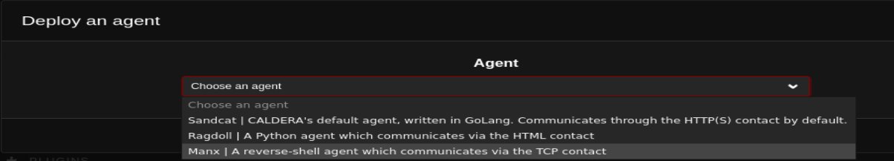

Slide 17
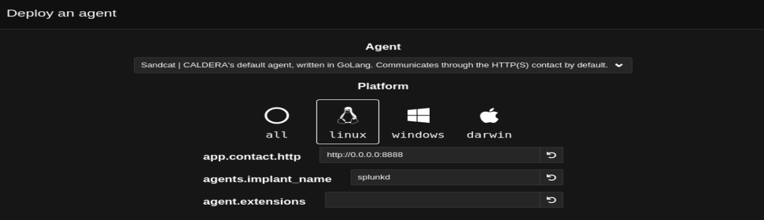
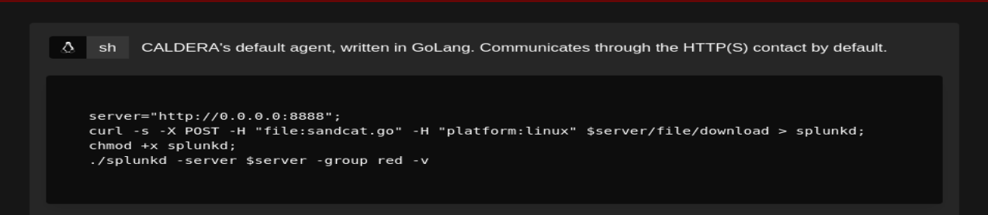

Slide 18
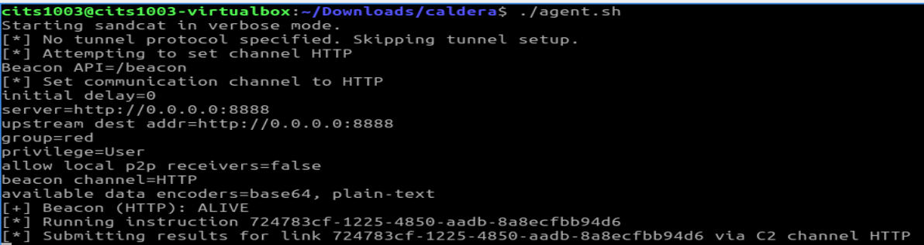

Slide 19
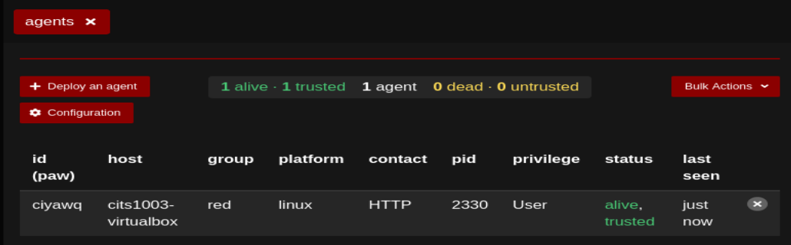

Slide 20
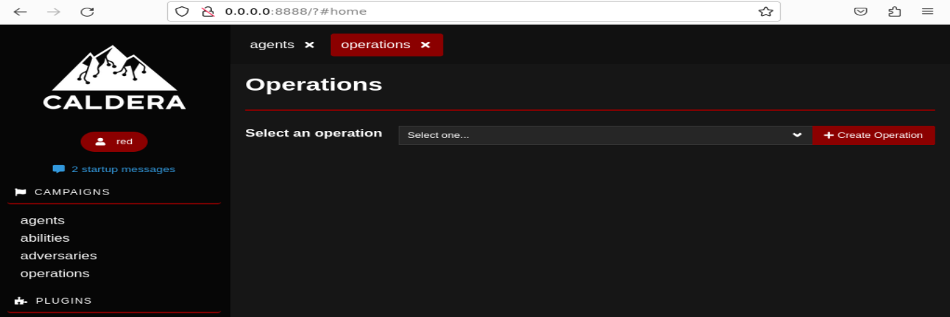

Slide 21
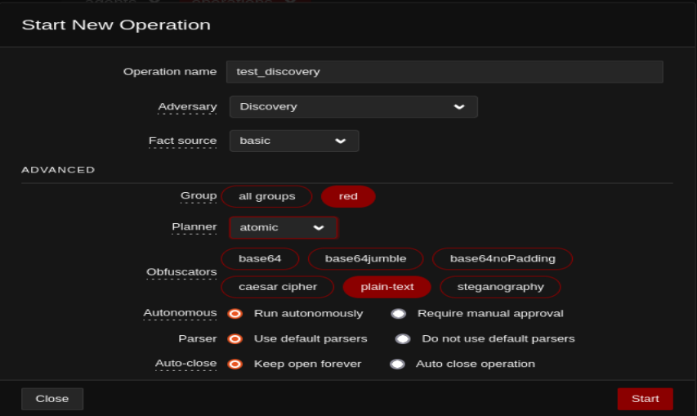

Slide 22
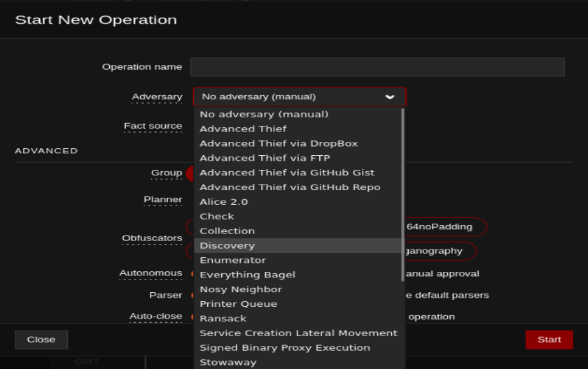

Slide 23
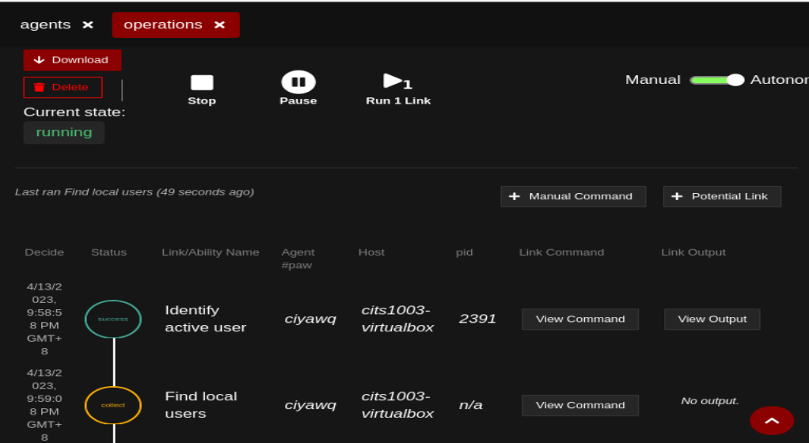

Slide 24
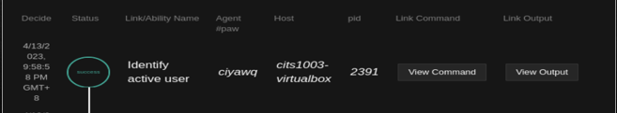
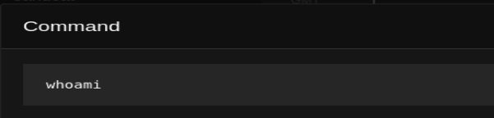
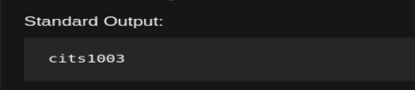

Slide 25
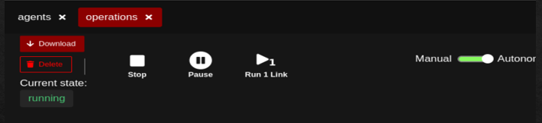
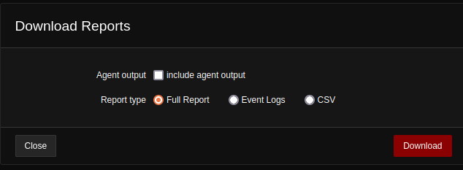

Slide 26
CALDERA
Why is CALDERA developed?
cyber range simulates real-world network environment that can be used to replicate real-world cyber scenarios.
red team is a group of security professionals who simulate cyber attacks and thus identify weaknesses that can be exploited by real attackers
blue team is a group of security professionals who respond to the simulated attacks and test their incident responses.

Slide 27
CALDERA
Why is CALDERA developed?
CALDERA provides a cyber-range environment.
A red team can automate simulated attacks that are modelled from real-world threat actors, identify weaknesses in a target organization’s network and test the incident-response mechanisms that are deployed.
Correspondingly, a blue team can inspect the effectiveness of their deployed defenses and incident-response mechanisms, thus improving their incident response capabilities, better preparing for real-world cyber threats and mitigating the risks associated with cyber attacks.

Slide 28
ADTool
What is ADTool?
ADTool, short for Attack-Defense Tree Tool, allows a user to model and analyze attack-defense scenarios using attack-defense trees.

Slide 29
ADTool
Installation
Download JDK (Java Development Kit) here: https://www.oracle.com/java/technologies/downloads/
Filename: jdk-17_windows-x64_bin.exe
Install JDK

Slide 30
ADTool
Installation
Download JDK here: https://www.oracle.com/java/technologies/downloads/
Install JDK
Download ADTool here: https://satoss.uni.lu/members/piotr/adtool/
Filename: ADTool-1.4-jar-with-dependencies.jar

Slide 31
ADTool
Installation
Download JDK here: https://www.oracle.com/java/technologies/downloads/
Download ADTool here: https://satoss.uni.lu/members/piotr/adtool/
Open PowerShell from the directory where the tool is downloaded
Run this command: java –jar .\ADTool-1.4-jar-with-dependencies.jar

Slide 32
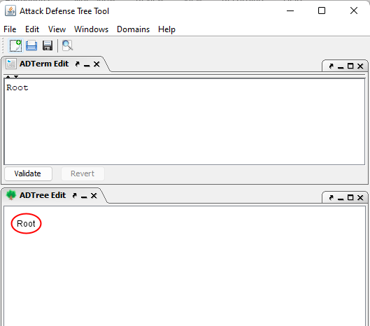
ADTool

Slide 33
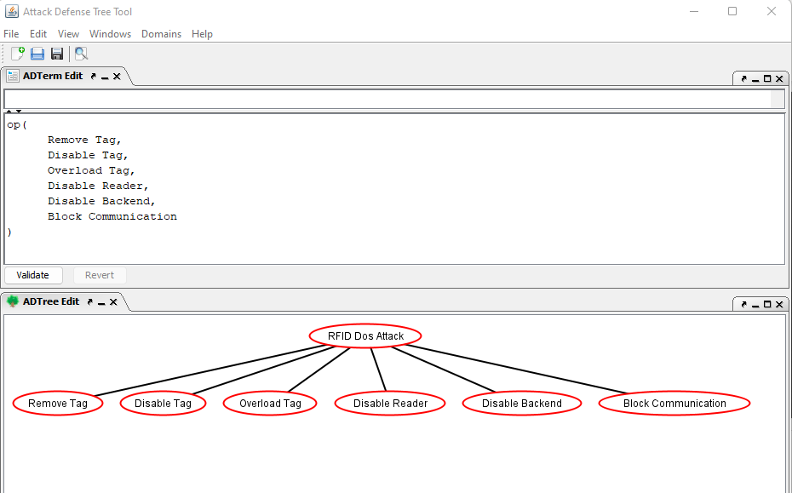

Slide 34
or proponents

Slide 35
or proponents
or
proponents

Slide 36
RFID: Radio Frequency Identification
RFID Tag:
RFID Reader
RFID Backend Server

Slide 37

RFID Tag
RFID Reader
RFID Backend Server
Tag attachment: every RFID tag, denoting a unique identifier (UID), is attached to an asset.
Reader installation: every RFID reader is installed in locations where assets pass through. These readers continuously look for RFID tags by emitting radio frequency signals.
Tag detection: When an asset passes within a range of the reader, its attached tag is detected. The tag sends its UID and geographic location to the reader. The reader then sends the information to an RFID backend server.
Server processing: The RFID backend server processes the information by verifying the tag's identity, updating the asset's location, etc.
Summary: The processed info is used to track the movement and location of assets in real-time.

Slide 39
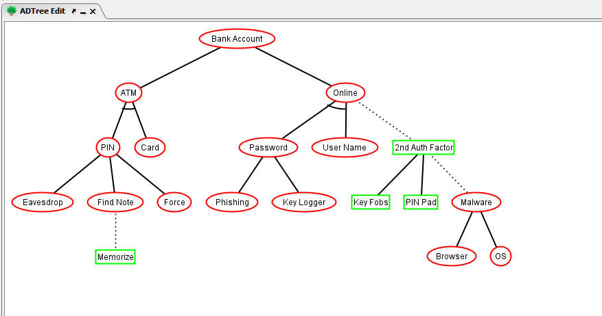
or proponents
op
op
op

Slide 40
op: or proponents
ap: and proponents
ap
?
op
op
?
?
op
?

Slide 41
op: or proponents
ap: and proponents
ap
?
opponent
op
op
oo: or opponents
?
opponent
opponent
op
?
opponent

Slide 42
op: or proponents
ap: and proponents
ap
cp
opponent
op
op
oo: or opponent
co: counter opponent
opponent
opponent
op
cp: counter proponent
opponent

Slide 43
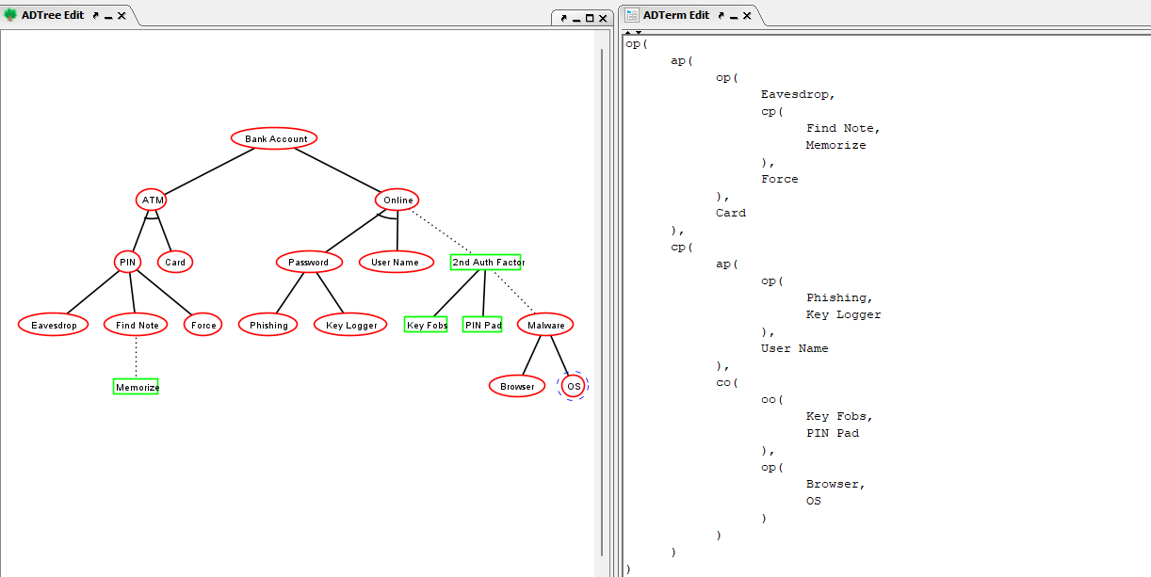

Slide 45
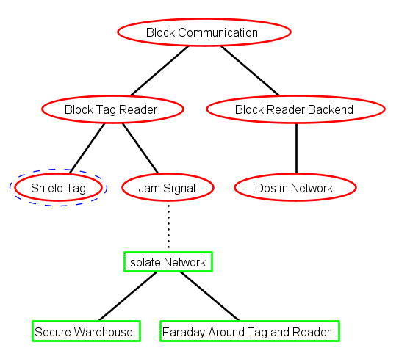
Exercise (tree translation)

Slide 46
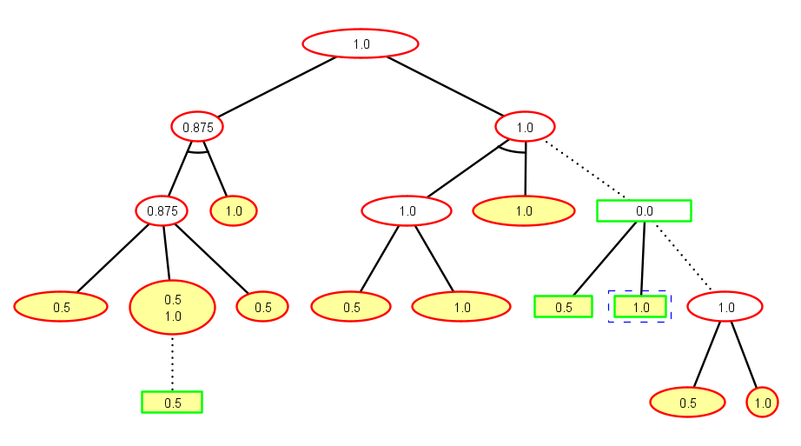
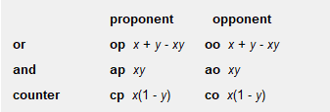
Exercise (success probability for the nodes)
0.75
1.0
0.0
1.0
0.5

Slide 47
Exercise (success probability for the nodes)
0.75
1.0
0.0
1.0
0.5

Slide 48
Exercise (success probability for the nodes)
0.75
1.0
0.0
1.0
0.5

Slide 49
Exercise (success probability for the nodes)
0.75
1.0
0.0
1.0
0.75
0.5

Slide 50
Exercise (success probability for the nodes)
0.75
1.0
0.0
0.75+0.5-0.75*0.5
1.0
0.5

Slide 51
Exercise (success probability for the nodes)
0.75
1.0
0.0
0.75+0.5-0.75*0.5
1.0
0.5

Slide 52
Exercise (success probability for the nodes)
0.75
1.0
0.0
0.75+0.5-0.75*0.5
1.0
0.75
0.5

Slide 53
Exercise (success probability for the nodes)
0.75
1.0
0.0
0.75+0.5-0.75*0.5
1.0
0.75
0.5

Slide 54
Exercise (success probability for the nodes)
0.75
1.0
0.25
0.75+0.5-0.75*0.5
1.0
0.75
0.5

Slide 55
Exercise (success probability for the nodes)
0.75
1.0
0.25
0.75+0.5-0.75*0.5
1.0
0.75
0.5

Slide 56
Exercise (success probability for the nodes)
0.75
1.0
0.25
0.75+0.5-0.75*0.5
1.0
0.75
0.5

Slide 57
Exercise (success probability for the nodes)
0.75
1.0
0.25
0.75+0.5-0.75*0.5
1.0
0.75
0.5

Slide 58
Exercise (success probability for the nodes)
0.875+0.75-0.875*0.75
0.96875
0.75
1.0
0.25
0.75+0.5-0.75*0.5
1.0
0.75
0.5

Slide 59
Project
Availability
Available at https://labs.cits1003.jinhong.org
Project Details
The project has four topics: (1) crypto; (2) computer architecture and network; (3) forensics; and (4) vulnerabilities.
Each topic has four challenges/questions (16 questions in total)
The questions have three difficulty levels: easy, medium and hard.
An easy question is 10 points, a medium question is 20 points, and a hard question is 25 points.
The total points are 250, worth of 25% of the final grade.

Slide 60
Project
How the project is graded
Your job is to find the flags for the 16 questions and obtain as many points as possible. Note: there are less hints for the project questions, as they are extended base on the lab questions. please apply the knowledge you have gained in the lectures and labs to help find the flags.
You need to submit a write-up report summarizing how a flag is found for each question. If your report clearly describes how you have found a flag, the points for this question will be retained. If not, you will lost the points.
If there is any misunderstanding in the report, you will be requested for an interview for clarification. If you fail to attend the interview, you can lose points for the questions that need clarifications. The interview session will be booked at your available time.
Your report is submitted on LMS as a single PDF file. Note: other file types will be ignored or unmarked.

Slide 61
Project
Duration
Starts on 17 April 2023 and closes at 5:00pm on 26 May 2023 (6 weeks in total).
Getting Help
You can attend any scheduled lab session for assistance including the one you are not allocated to. Our lab facilitators provide hints for you to explore from.
You are also encouraged to discuss on Teams. Note: hints/approaches are welcome. Sharing flags directly can be penalized.

Slide 62
Project
Academic Misconduct
If you are unsure whether what you are going to do would be academic misconduct, please check with our lab facilitators or me.
Please do not seek to get the flags from anyone else.
Please do not share the flags you have found.
The written-up report will be inspected by plagiarism detection software

